Slide 1

SKIN CANCER DETECTION
USING MACHINE LEARNING
Final Review
TEAM MEMBERS
Elakkiyan.R
Kabil.A GUIDE NAME
Sridhar.S.P Dr.Sangeetha

Slide 2
INTRODUCTION
1.Skin cancer is one of the most common types of cancer.
2. It can become dangerous if not detected early.
3.Early identification of abnormal skin lesions helps patients receive proper treatment at the right time.
4.Traditional detection mainly relies on visual examination by doctors.
5.This manual visual examination can be difficult and time- consuming.

Slide 3
ABSTRACT
1.Skin Cancer Detection System
2.Skin cancer: Common type of cancer; early detection supports better treatment.
3.Objective: Develop a skin cancer detection system using ML & CNN.
4.Input: diverse datasets Skin lesion image.
5.Preprocessing: Enhances image quality for better analysis.
6.CNN Model: Trained on different skin lesion images.
7.Features: Learns shape, all color, texture & patterns.
8.Classification: Predicts Benign or Malignant.
9.Benefits: Supports early screening and reduces initial detection time
10.Limitation: Acts as a supportive tool and does not replace professional medical diagnosis.

Slide 4
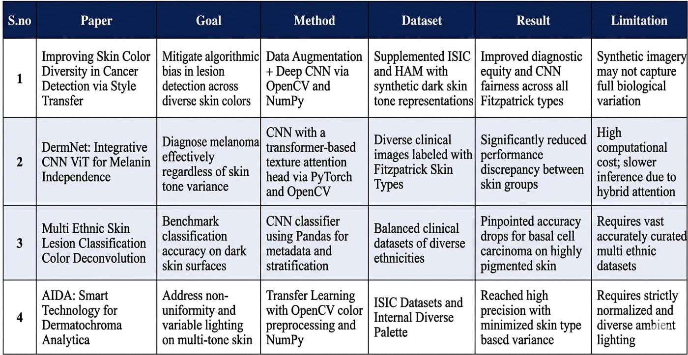
BASE PAPER

Slide 5
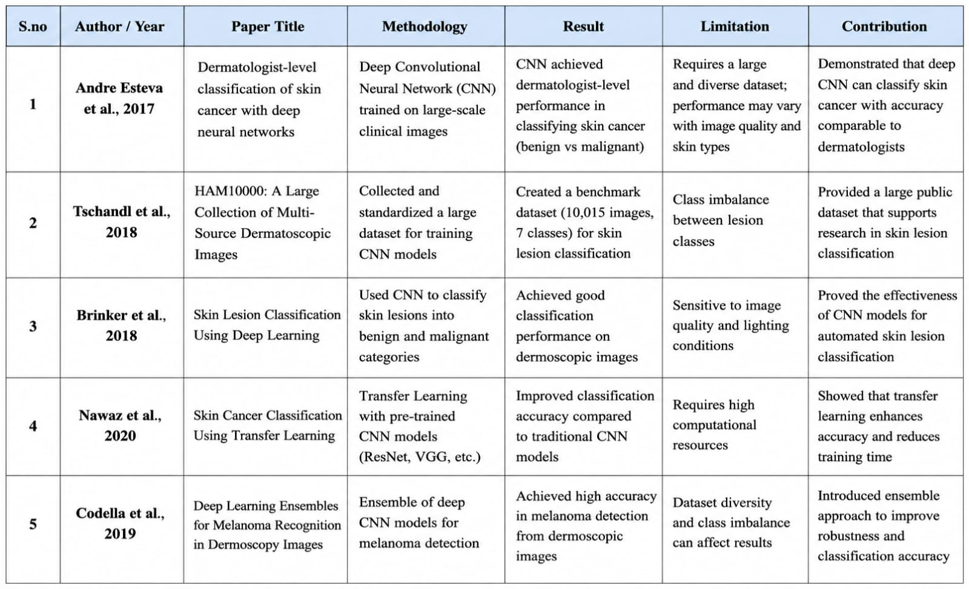
LITERATURE SURVEY

Slide 6
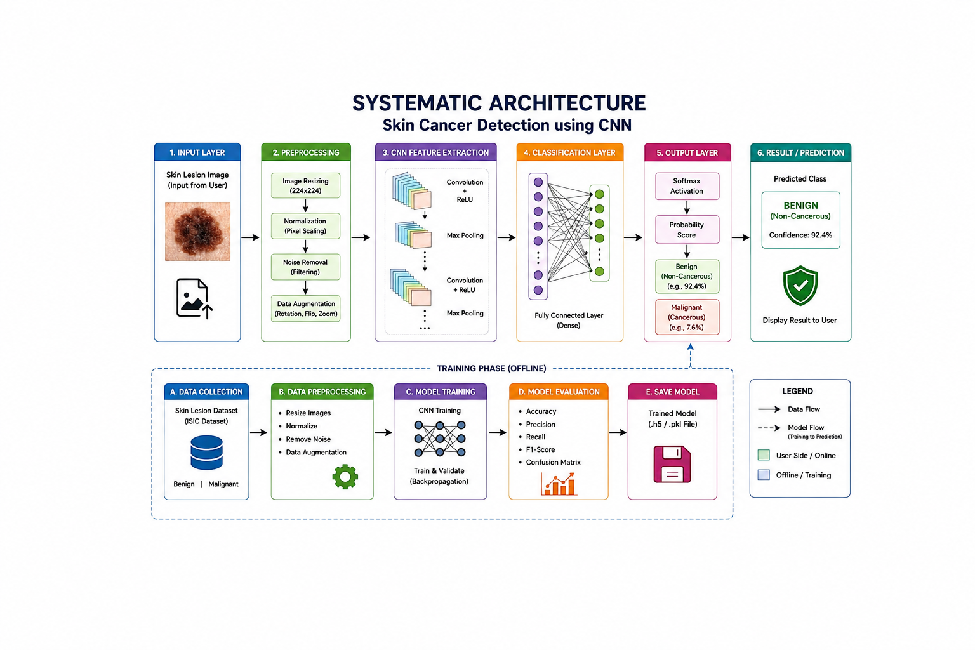
Content Title 03

Slide 7
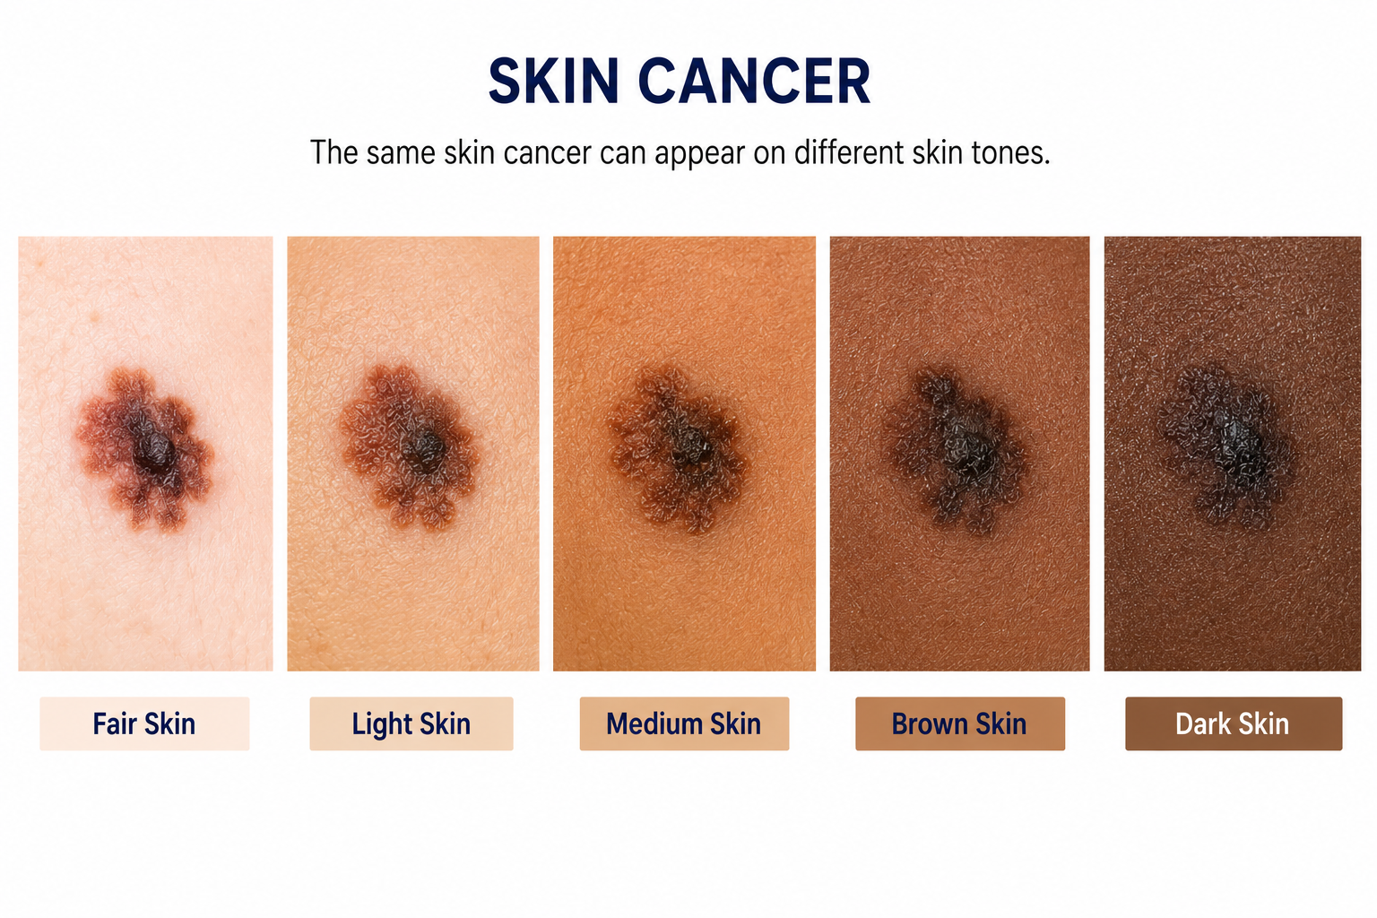

Slide 8
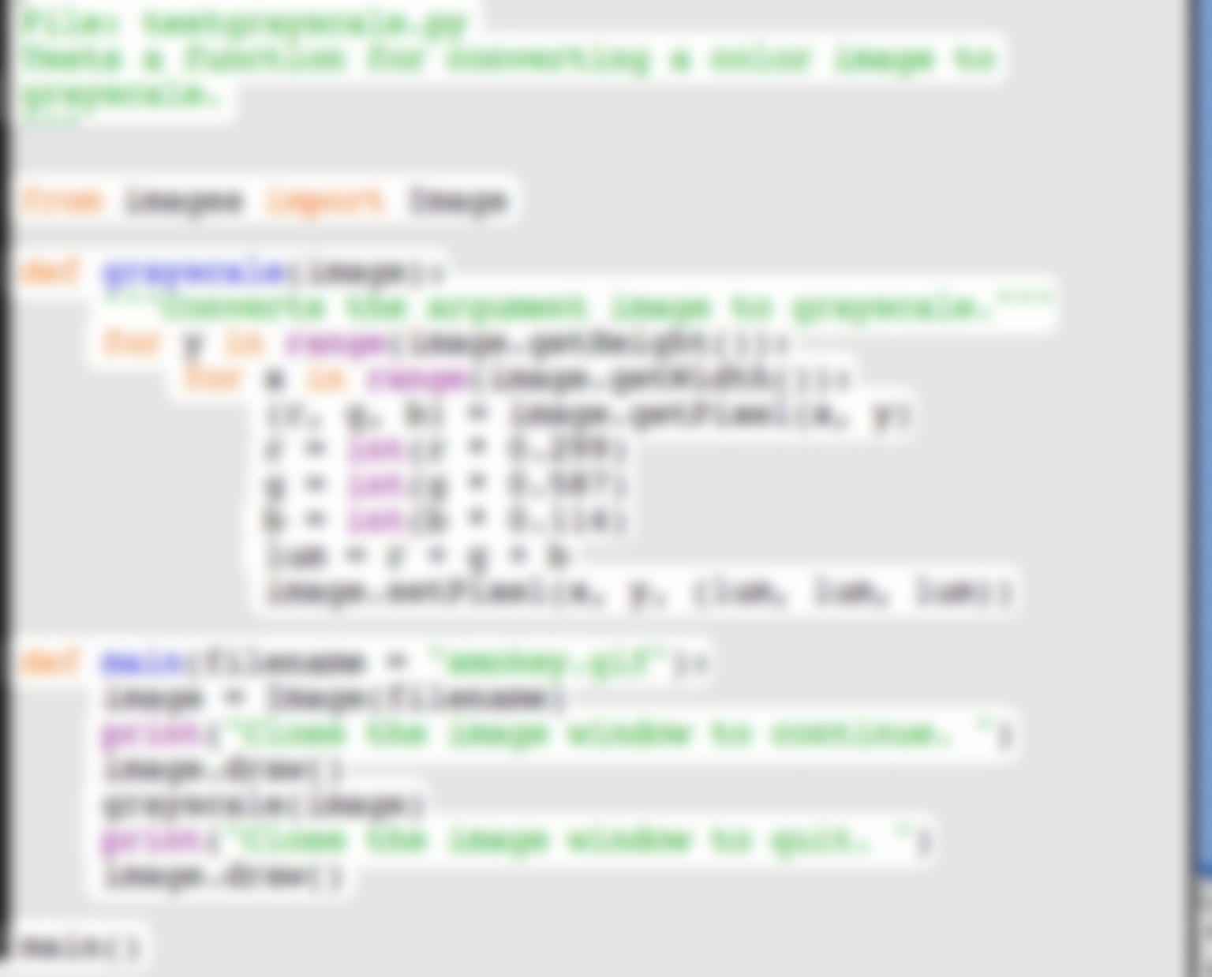
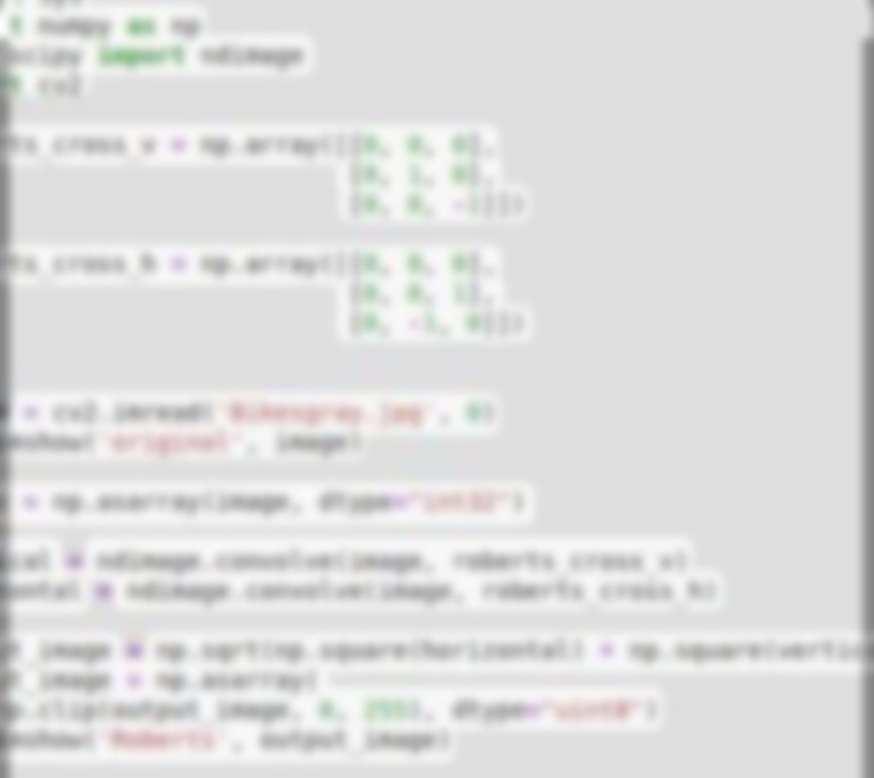
PROBLEM IMPLEMENTATION

Slide 9
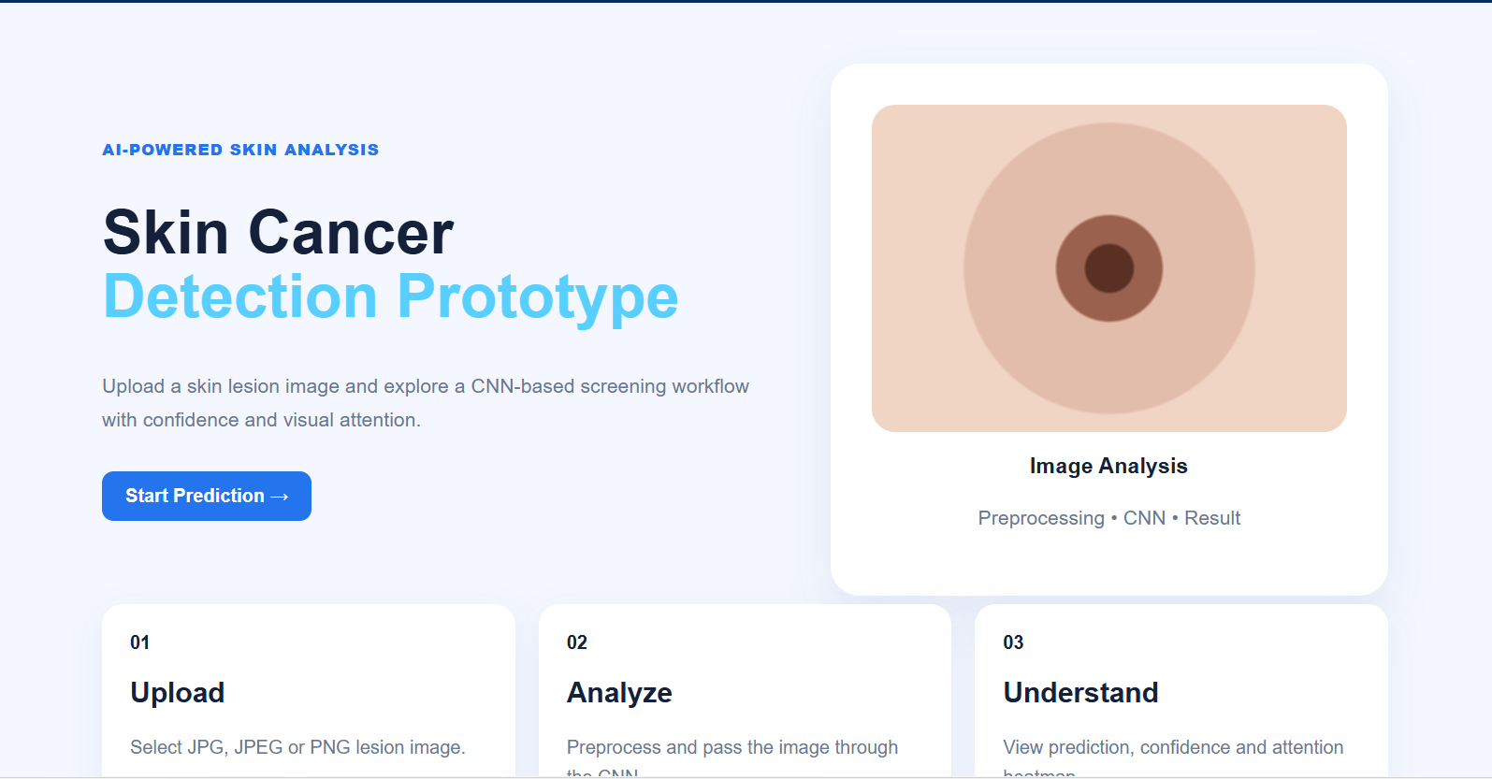
IMPLEMENTATION

Slide 10
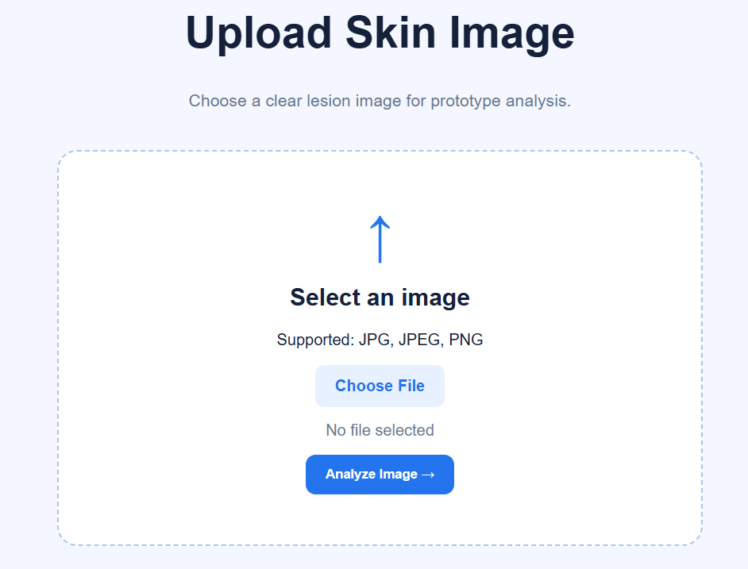

Slide 11
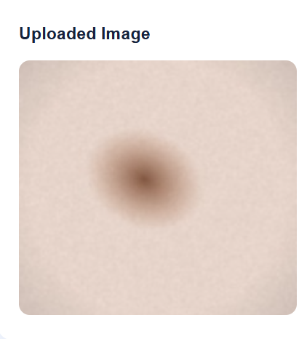
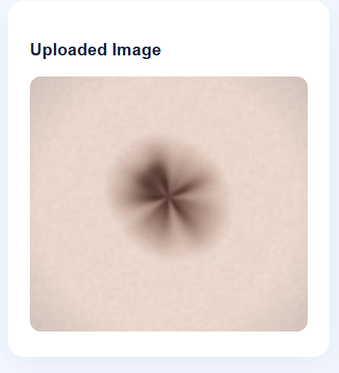

Slide 12
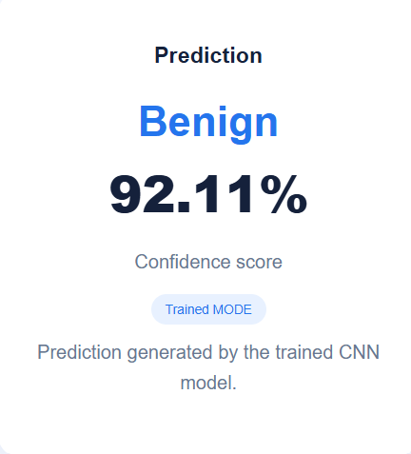

Slide 13
Detection of Skin Cancer Using Machine Learning: A CNN-Based Preliminary Screening System
Elakkiyan R¹, Kabil A², Sridhar S P³ , Sangeetha G⁴
¹,²,³ B.Tech Computer Science and Engineering (Artificial Intelligence), VISTAS
Department of Computer Science and Engineering (Artificial Intelligence), Vels Institute of Science, Technology & Advanced Studies
Pallavaram, Chennai, India
Email id : elakkiyan15432@gmail.com ,antonykabil55@gmail.com
Abstract
Early identification of skin cancer can improve treatment outcomes, but access to expert assessment is not always available. This paper presents a machine-learning-based preliminary screening system that analyses skin-lesion images using a convolutional neural network (CNN). The proposed workflow includes image collection, preprocessing, CNN training, testing, prediction and result display through a Flask-based web interface. Input images are converted to RGB, resized to a fixed size and normalised before being passed to the CNN, which learns visual features such as shape, colour and texture. To reduce the effect of class imbalance, class weighting and data augmentation are incorporated during training. The system produces a preliminary benign or malignant prediction and displays the result with a clear disclaimer that it is not a medical diagnosis. The proposed prototype is implemented using Python and is designed to provide a simple and accessible screening-support tool. Performance is intended to be evaluated using accuracy, precision, recall, F1-score and a confusion matrix, with future work focusing on diverse skin tones, explainable AI and independent clinical validation.
Keywords— Skin cancer detection, Convolutional Neural Network (CNN), Machine Learning, Skin-lesion Classification, HAM10000, ISIC, Preliminary Screening, Flask.
CONFERENCE PAPER

Slide 14
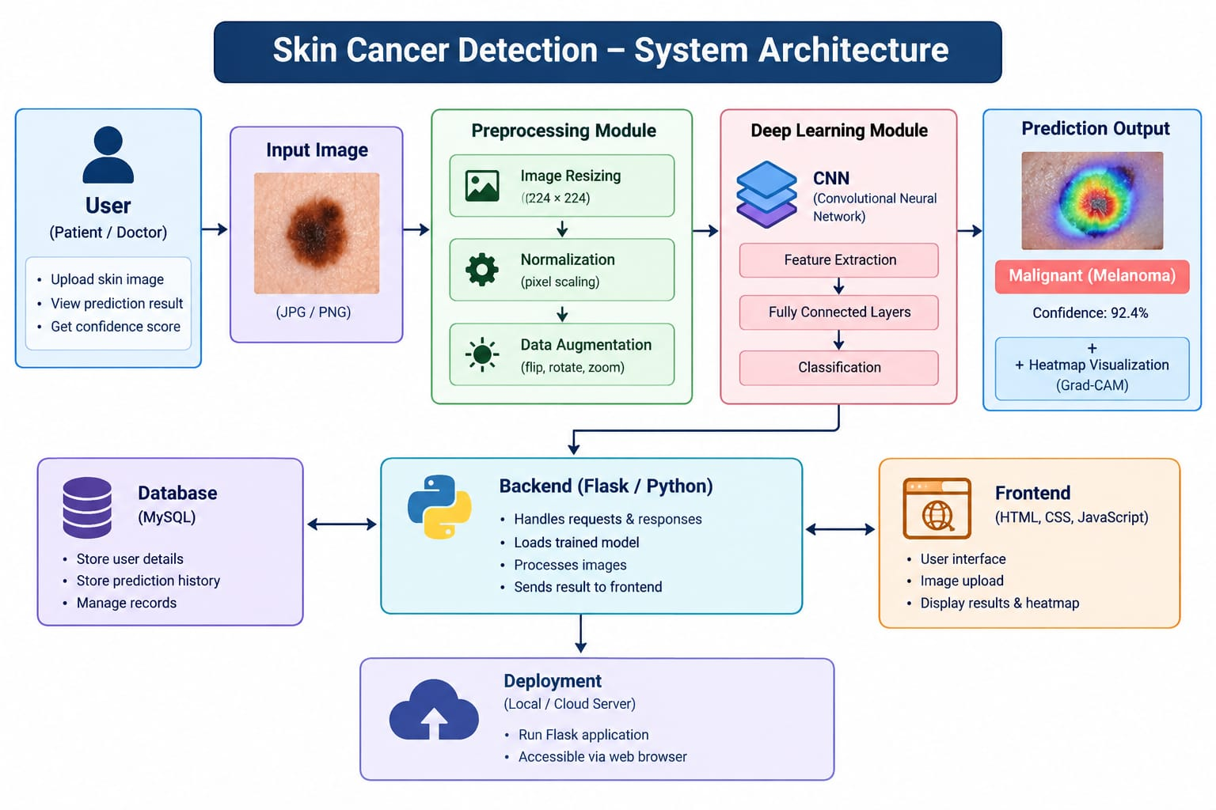

Slide 15
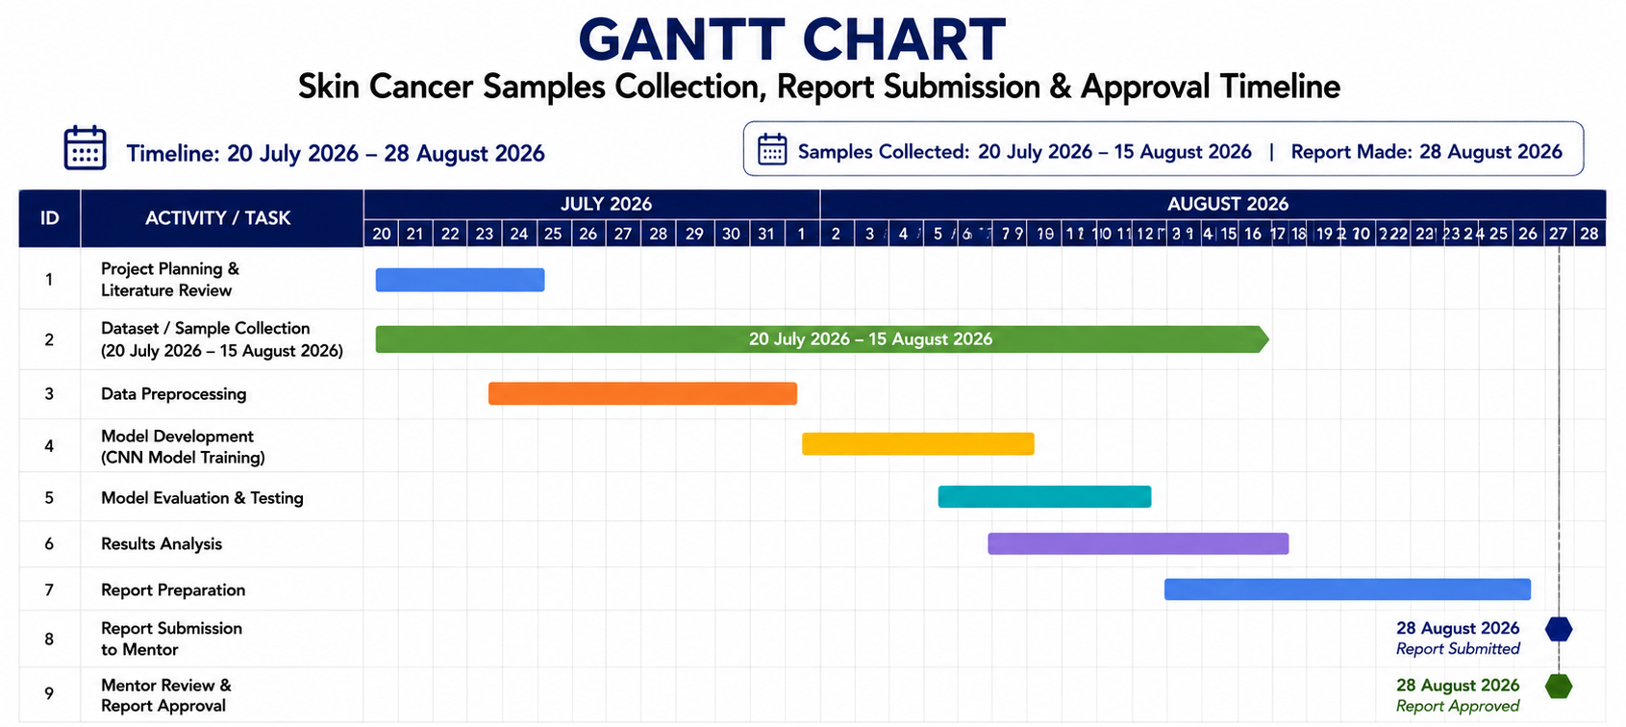
GANTT CHART

